Slide 1
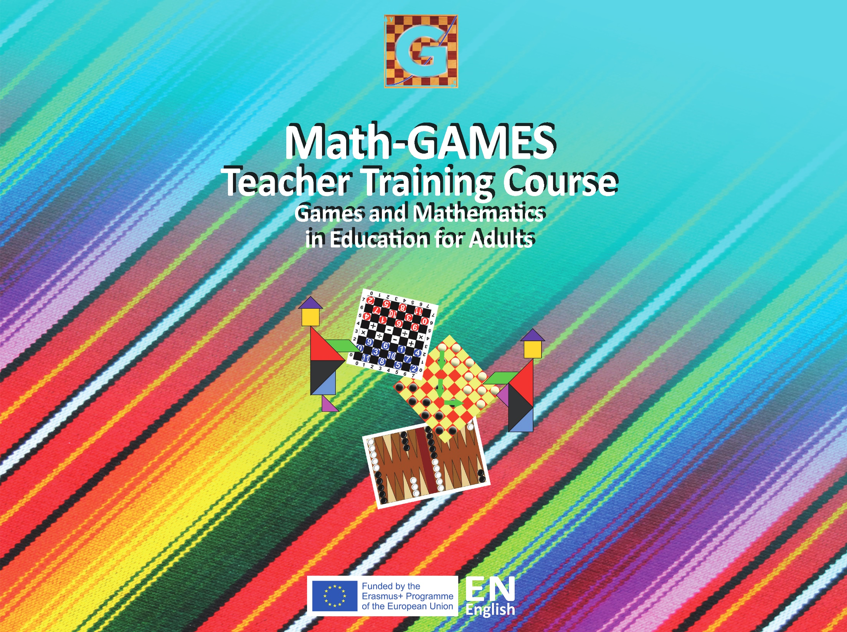

Slide 2
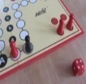
5.1 Mensch ärgere Dich nicht (Engl. Ludo)
Objectives
Count reliably up to 6 items
Read and write numbers up to 40
Order, compare and add numbers up to 6
Subtract single-digit numbers from numbers up to 6
Coordinate different figures in their positions (holistic overview)
Compare, count and organize own and other pieces
Experiencing and training in complexity (in groups of 2-6 players)
How to deal with emotions in small groups

Slide 3
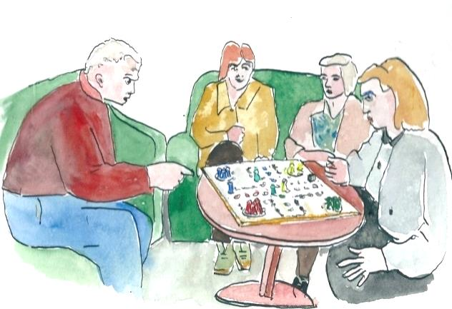
5.1 Mensch ärgere Dich nicht (Engl. Ludo)
Tools, Materials and Organisation
A group of 2 to 6 persons is sitting around the board on a table
Each person has his four pieces in one of the colours:
Black, yellow, red or green on the game board with 4 sections
Black, yellow, red, green, blue or violet on the game board with 6 sections.

Slide 4
5.1 Mensch ärgere Dich nicht (Engl. Ludo)
Description of the Lesson
First part of the lesson (10 minutes):
Learning the rules
Make a group of 2 to 6 participants and chose a board.
Each person has four figures in one of the colours.
These figures have to be raced from start (“waiting”- or “out”-field) to finish (“home”-field) clockwise according to dice rolls.
The field must be circled once as quickly as possible.
→ Without getting caught by the “enemy”!
The first player with all of the pieces in the "home" row wins the game.

Slide 5
5.1 Mensch ärgere Dich nicht (Engl. Ludo)
Classical rules:
  3 times rolling the dice (if no figures on the field)
  Outplacing = Priority (6 on dice = figures from “out” area → game-field)
  Vacating the starting field = Priority (it has to be free of figures)
  Moving on normally (clockwise, according to the thrown number)
  Kicking out is duty (if a goal-field is occupied)
Play the game several times and note the winner.

Slide 6
5.1 Mensch ärgere Dich nicht (Engl. Ludo)
Second part of the lesson (35 minutes):
Training in complexity and experiencing the differences
Playing the game
(a) with 2 persons – and 8 pieces
(b) with 4 persons – and 16 pieces
(c) with 6 persons – and 24 pieces
Writing notes by the participants:
  results
  annotations about the feelings when playing with two, four or six players.
Discussion about the “training in complexity” in the whole group.

Slide 7
5.1 Mensch ärgere Dich nicht (Engl. Ludo)
Useful Hints:
  Another variant for a “Training in complexity”:
    Pieces race back to the starting field (Question: Which kind of strategies are needed for this “reverse variant”?)
  Additional rule: A Six is needed before going back from field A into the starting field B.
  The board game could also be played with even more than 6 participants.
Introduction: www.youtube.com/watch?v=vTCnzPxSk0M
Comic & funny: www.youtube.com/watch?v=NwGi2XMel-0

Slide 8
